Slide 1
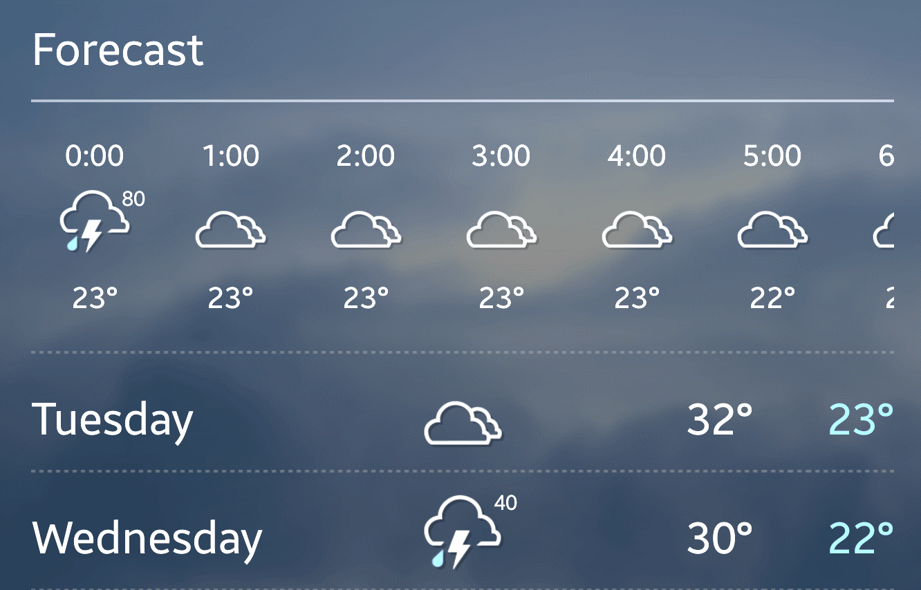
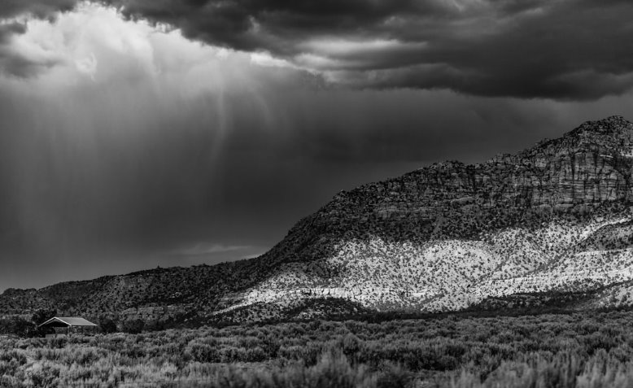
WEATHER FORECASTING USING MACHINE LEARNING (GROUP A)
STEP PRESENTATION BY:
• AESHA CHITRAKET SAVANI • DEVANSHI ADHIKARI
• SHABDA KAFLE • CLIFFORD ADDISON
• SAFNA MOHAMMED FAYAS • MUEEZ UR REHMAN AMJAD
• JEFFIN JOHN ABRAHAM • ADVAIT MANISHKUMAR PANDIT
• NITHISH JANAGAM • AMRUTH RAJ MANCHIKANTI

Slide 2
Project overview & Objectives
Project Overview
Model Training & Forecasting
Project Objectives
The Weather Forecasting using Machine Learning project aims to develop accurate weather prediction models utilizing machine learning algorithms. It seeks to leverage historical weather data to create a reliable forecasting system.
The project aims to develop a comprehensive prediction model based on historical weather data, explore and pre-process the collected data, implement a machine learning algorithm, and optimize the model for accuracy and efficiency.
The project also aims to train initial models using pre-processed data, evaluate model performance, and deploy the final weather forecasting model for real-time predictions.

Slide 3
PROJECT SCOPE
The project scope includes phases for project management, solution flow, data management, analysis, and documentation.

Slide 4
PROJECT DELIVERABLES
The detailed timeline covers the duration and leads for different project phases, including task assignment, data management, and documentation.
Deliverables
Cleaned and pre-processed weather dataset.
Trained machine learning models for weather forecasting.
Final deployment for real-time predictions.
Project presentation slides and documentation.

Slide 5
Application and benefits
Weather Forecasting Applications
Advantages of Using Machine Learning
Benefits of Machine Learning in Weather Forecasting
Machine learning is applied to weather forecasting for various purposes, including long-term climate predictions, short-term weather forecasts, and extreme weather event detection.
Machine learning enables accurate and timely weather predictions, leading to improved disaster preparedness, agricultural planning, and energy management. It also aids in optimizing transportation systems and enhancing public safety.
The incorporation of machine learning in weather forecasting results in more precise, reliable, and localized weather predictions, thus benefiting industries such as agriculture, aviation, and renewable energy.

Slide 6
Project timeline
Initiation – Week 1
Planning – Week 1
Task Allocation – Week 2
Scheduling – Week 2
Execution – Week 3 – 5
Documentation – Ongoing
Scope – Week 1
The project will deliver a cleaned and pre-processed weather dataset, trained machine learning models for weather forecasting, final deployment for real-time predictions, and project presentation slides and documentation

Slide 7
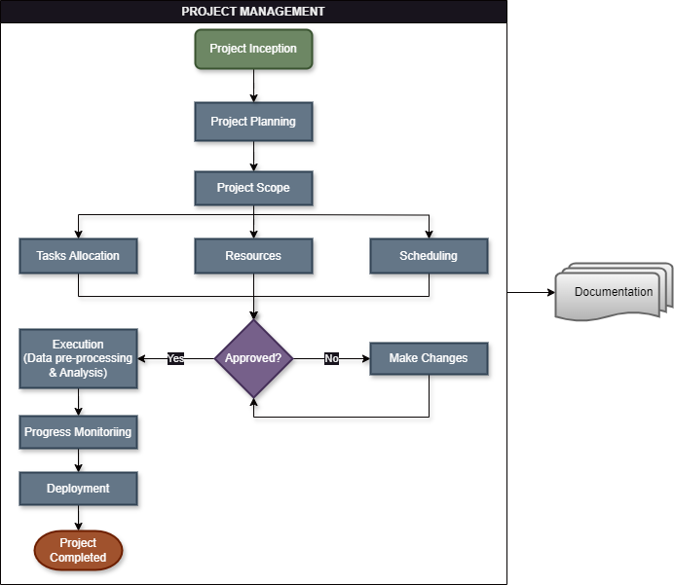
Project management

Slide 8
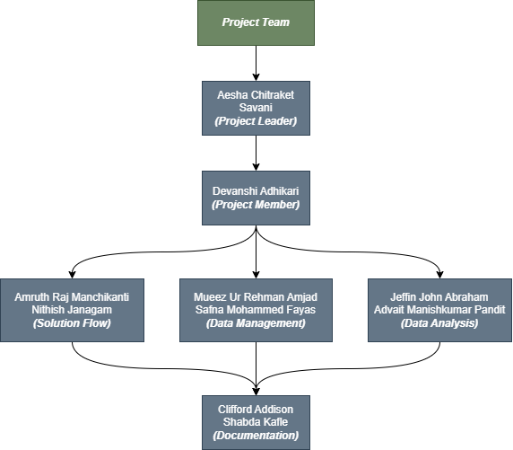
Project team

Slide 9

PROJECT TASKS
The project involves data collection, solution flow, data management, data analysis - model training and evaluation, and developing an efficient machine learning model for real-time weather forecasts.
Tasks are managed on "Trello" Project Board.
Every aspect of this project will be well documented.

Slide 10
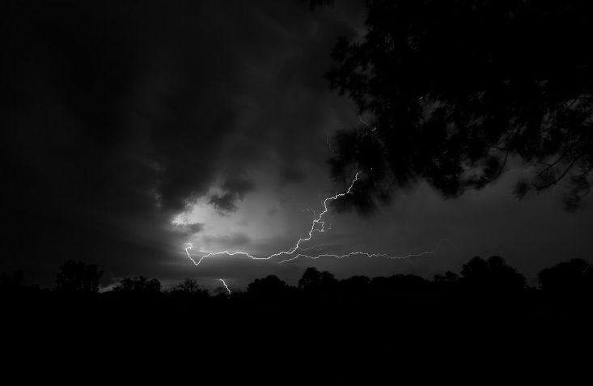
Machine learning models
In this project, we will be using supervised machine learning model such as regression for weather prediction.
This will help with the identification of patterns and trends in the historical weather data we have collected.

Slide 11

Data collection and preprocessing
The key features in the data we have collected include:
Station: The station ID of the data
Name: Name of the city or place
Date: Date of the observation
PRCP: Precipitation
Snow: Snow in inches
SNWD: Snowfall Depth
TAVG: Average temperature of the day
TMAX: Maximum Temperature of the day
TMIN: Minimum Temperature of the day
WDFG: Direction of Peak wind gust (degrees)
WSFG: Peak Gust wind speed (miles per hour)

Slide 12
Data collection and preprocessing
We utilized preprocessing techniques such as outliers' detection, missing data imputation, and data transformation, where we converted the temperature unit from Fahrenheit to Celsius.
These techniques ensure data quality, consistency, and reliability before being inputted into our chosen machine-learning algorithm(s) for training, validation, and testing.
The total observations in our data is 3,960.

Slide 13
Performance evaluation
During the evaluation of the performance of our machine learning model, we might be using metrics such as:
Mean Absolute Error (MAE)
Root Mean Square Error (RMSE)
To gauge the predictive capabilities and reliability of machine learning model in weather forecasting applications.

Slide 14
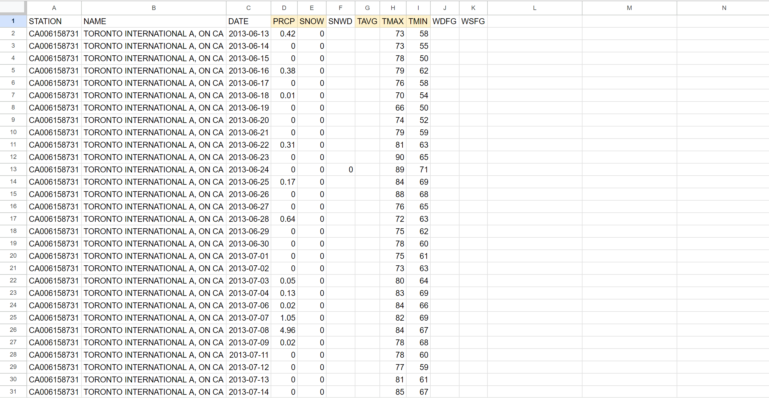
Data collection and preprocessing
The data for this project was collected from the National Oceanic and Atmospheric Administration https://www.noaa.gov/ in its RAW STATE.

Slide 15
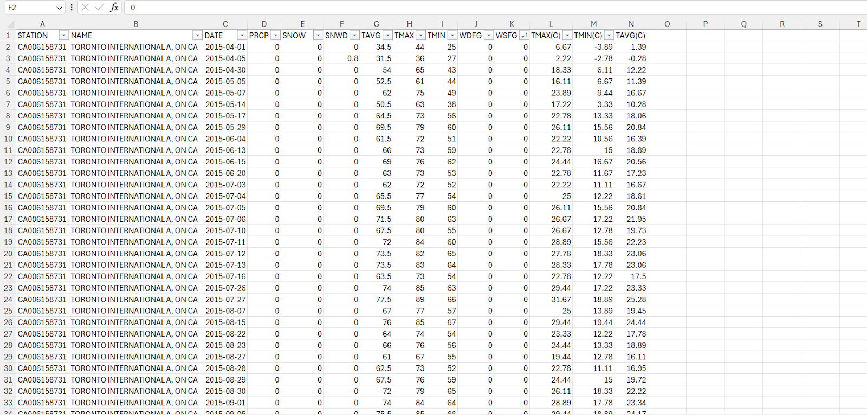
Data collection and preprocessing
Below is the dataset after DATA CLEANING AND PREPROCESSING.

Slide 16
Data Analysis
In our dataset, we have multiple output features, making multiple linear regression an ideal choice for handling the data effectively. This method provides coefficients for each predicting variable, allowing us to identify the strength of each variable in relation to the target variable. Multiple linear regression can perform complex calculations and can help us identify non-linear features, enabling us to address and fix them. Additionally, it aids in simplifying the model and reducing overfitting.
Moreover, multiple linear regression is easy to implement and interpret. It allows for the measurement of data uncertainty through confidence intervals for forecasting values, and it helps us uncover data trends.

Slide 17
Challenges and failings – Week 4
During the data preprocessing phase, we faced the following challenges and resolved them:
There were some missing (blank) values in the “PRCP” column. Therefore, we considered that the value at that time was zero and replaced them with zero suggesting that there was no precipitation on that day.
The “SNOW” column had missing values that indicated that there was no snowfall during that period. We made this conclusion because we observed that most of the dates fell in the summer season and snowfall was not possible at that time.

Slide 18
Challenges and failings – Week 4
During the data preprocessing phase, we also faced the following challenges and resolved them:
The "SNWD" column had some missing values. However, upon cross-referencing with the Snowfall data, we found that there was no snowfall during those observations. Therefore, the missing values indicate there was no snow depth.
The "TMAX" column had some missing values for the maximum temperature of the day. To complete the data, we retrieved the missing temperature values from the internet.
Similarly, the "TMIN" column had some missing values for the minimum temperature of the day. We also used online sources to fill in these missing temperature values.

Slide 19
Resources used
Weather Forecasting Data
Weather and climate resources. (n.d.). National Oceanic and Atmospheric Administration. https://www.noaa.gov/tools-and-resources/weather-and-climate-resources
Integrated Development Environment (IDE)
Google Colab. (n.d.). https://colab.research.google.com/drive/1dWyOce5CaHdpKfGFr_aRp6KZk29rMIaM?usp=sharing

Slide 20
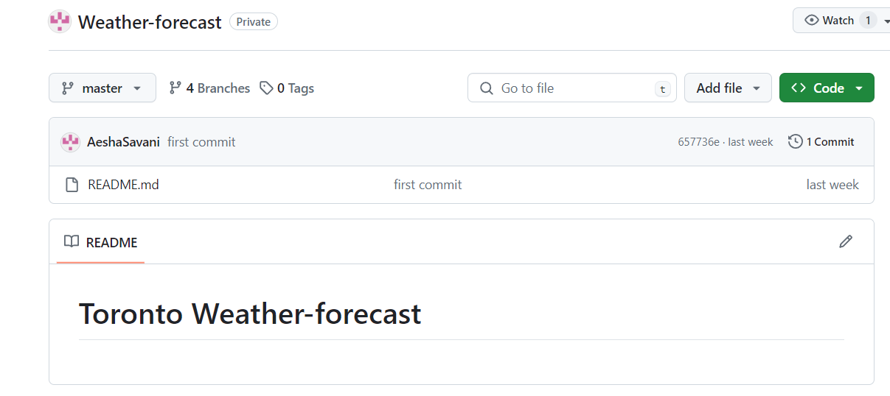
Resources used
Repository
AeshaSavani/Weather-forecast. (n.d.). GitHub. https://github.com/AeshaSavani/Weather-forecast

Slide 21

Resources used
Project Board
Manage your team’s projects from anywhere | Trello. (n.d.). https://trello.com/

Slide 22
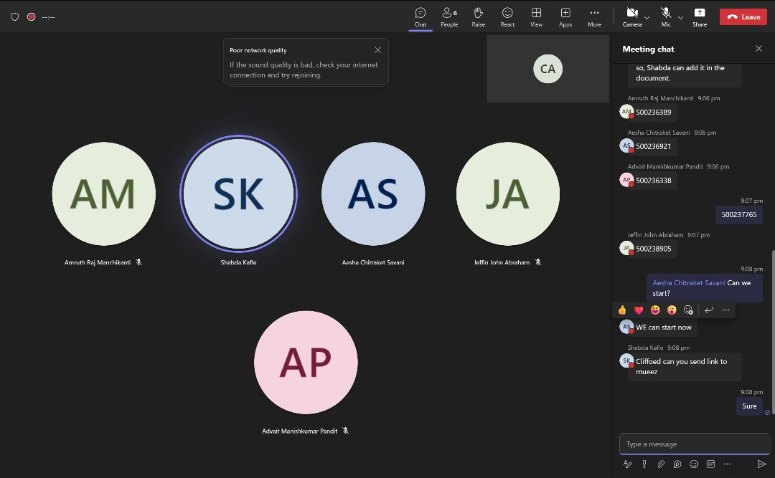


dAILY STAND-UP MEETING
We engage in a daily stand-up meeting to discuss the progress of the project and identify blockers.

Slide 23
future directions and conclusion
In conclusion, we addressed the issue of missing values in our dataset to ensure its completeness and accuracy.
With that phase completed, we will proceed on run various tests using multiple models to identify the best-performing one for our training and testing phases.
This thorough approach will allow us to select the most suitable model, ensuring robust and reliable outcomes in our analysis.

Slide 24
THANK YOU

